Slide 1
SPATIAL ANALYSIS TECHNIQUE AND THEMATIC REPRESENTATION IN GIS
DR. PRASENJIT DAS

Slide 2
Spatial Analysis What is it?
One Definition: the quantitative procedures employed in the study of the spatial arrangement of features (points, lines, polygons and surfaces.
“…the purpose of geographic inquiry is to examine relationships between geographic features collectively and to use the relationships to describe the real-world phenomena that map features represent.” (Clarke 2001, 182).

Slide 3
GIS systems really come into their own when they are used to analyze geographic data. The processes of geographic analysis often called spatial analysis or geo-processing uses the geographic properties of features to look for patterns and trends, and to undertake "what if" scenarios. Modern GIS have many powerful analytical tools to analyse the data.

Slide 4
Spatial data analysis
Usually involves manipulations or calculation of coordinates or attribute variables with a various operators (tools), such as:
Measurement
Overlay
Reclassification
Buffering
Network Analysis
Notes:
Projects may contain both raster and vector data sets, but analysis is restricted to one data model of the other.

Slide 5
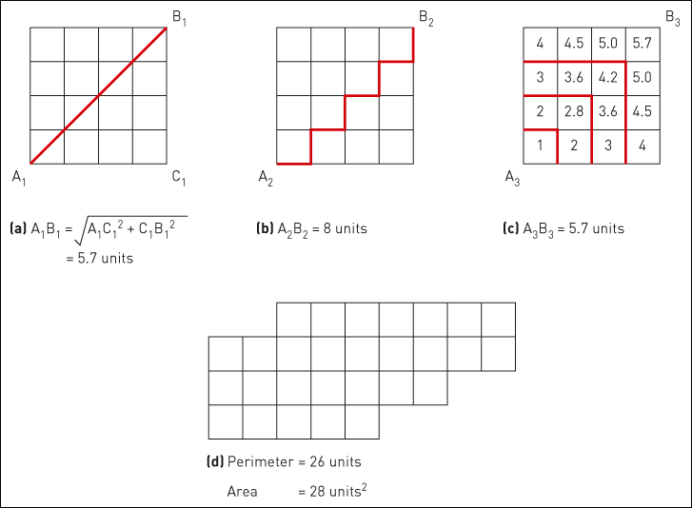
Figure 6.1 Raster GIS measurements: (a) Pythagorean distance, (b) Manhattan distance, (c) proximity distances and (d) perimeter and area

Slide 6
Spatial data analysis
Usually involves manipulations or calculation of coordinates or attribute variables with a various operators (tools), such as:
Measurement
Overlay
Reclassification
Buffering
Network Analysis

Slide 7
Overlay Analysis
The integration of different data layers involves a process called overlay. At its simplest, this could be a visual operation, but analytical operations require one or more data layers to be joined physically. This overlay, or spatial join, can integrate data on soils, slope, and vegetation, or land ownership. For example, data layers for soil and land use can be combined resulting in a new map which contains both soil and land use information. This will be helpful to understand the different behaviour of the situation on different parameters.

Slide 8
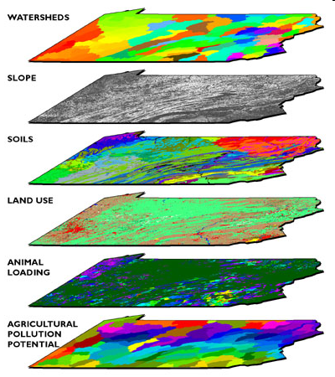
Overlay
Combination of different data layers
Both spatial and attribute data is combined
Requires that data layers use a common coordinate system
A new data layer is created

Slide 9
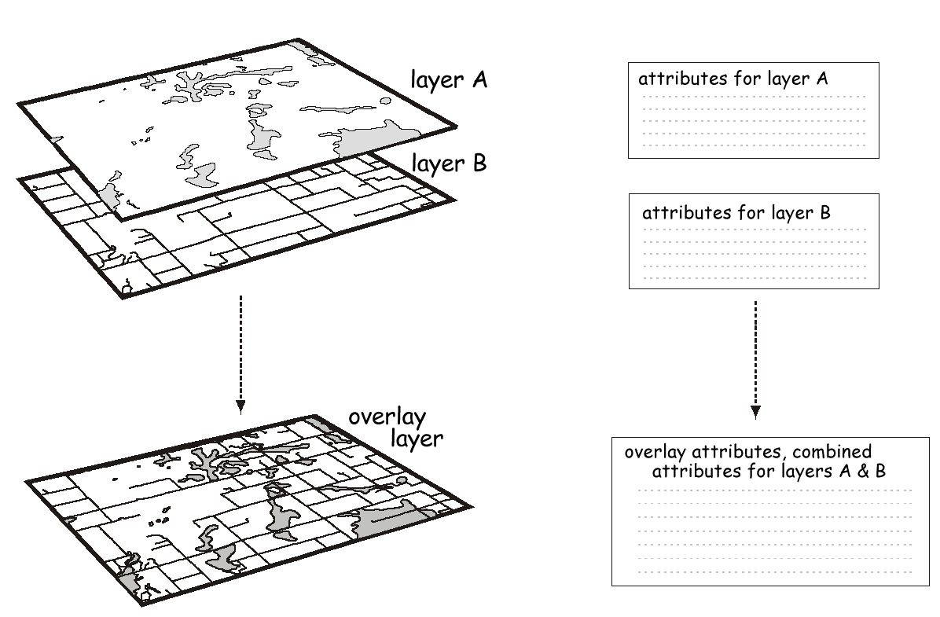

Slide 10
Spatial data analysis
Usually involves manipulations or calculation of coordinates or attribute variables with a various operators (tools), such as:
Measurement
Queries & Selection
Reclassification
Buffering
Overlay
Network Analysis

Slide 11
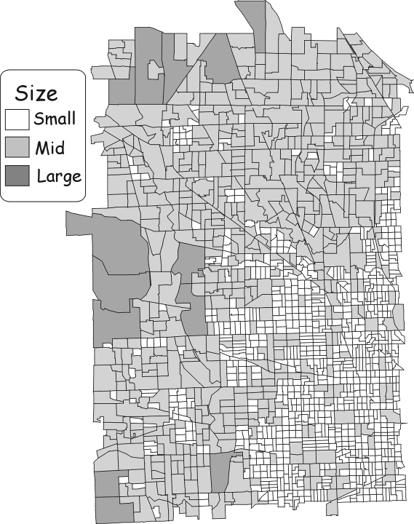
Spatial data analysis: Reclassification
An assignment of a class or value based on the attributes or geography of an object
Example:
Parcels
Reclassified
By size

Slide 12
Spatial data analysis
Usually involves manipulations or calculation of coordinates or attribute variables with a various operators (tools), such as:
Measurement
Queries & Selection
Reclassification
Buffering
Overlay
Network Analysis

Slide 13
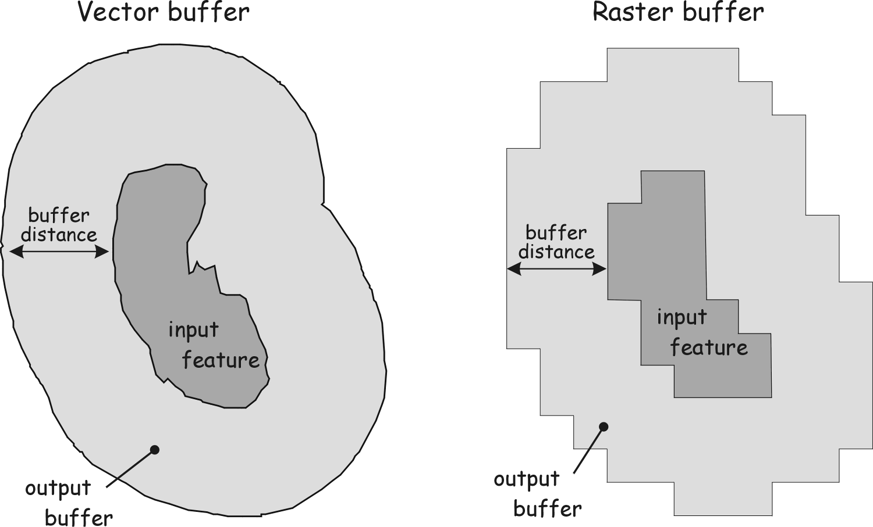
Buffering and other Proximity Functions

Slide 14
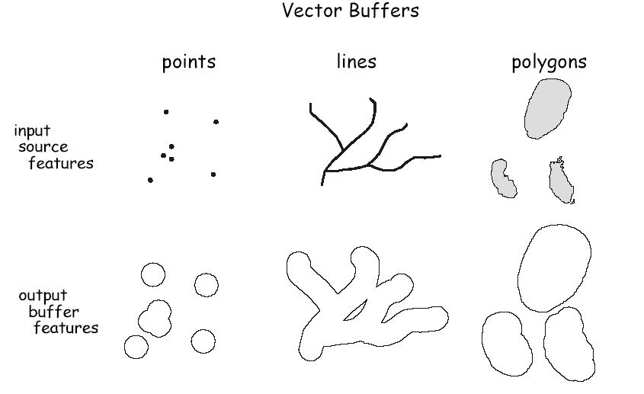

Slide 15
Spatial data analysis
Usually involves manipulations or calculation of coordinates or attribute variables with a various operators (tools), such as:
Measurement
Overlay
Reclassification
Buffering
Network Analysis

Slide 16
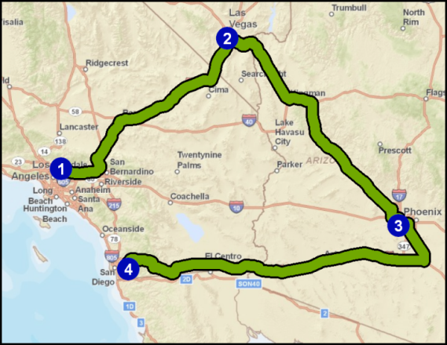
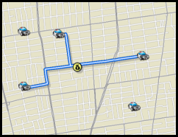
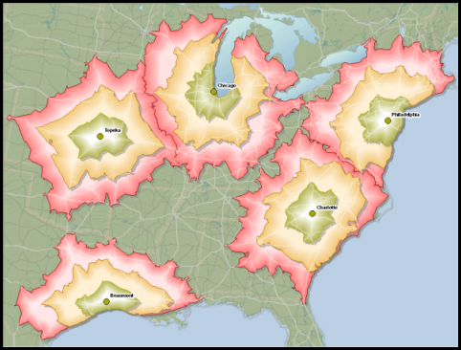
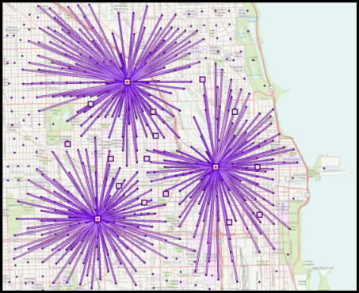
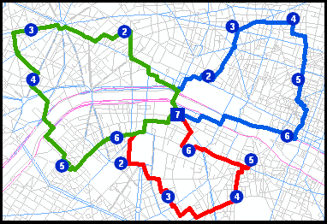
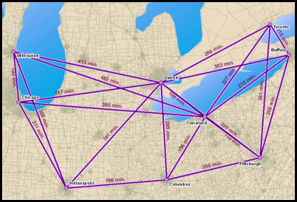
ArcGIS Network Analyst Extension Solving transportation problems
Route
Closest Facility
Service Area
Location-Allocation
Vehicle Routing
Problem
Origin-Destination
Cost Matrix

Slide 17
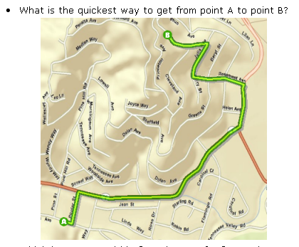
Shortest Path: Drive Time or Distance

Slide 18
Cost Attributes - Drive Time

Slide 19
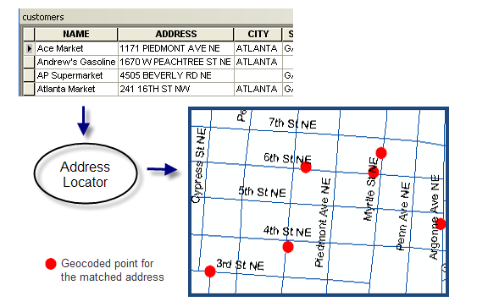
Geocoding - Addresses

Slide 20
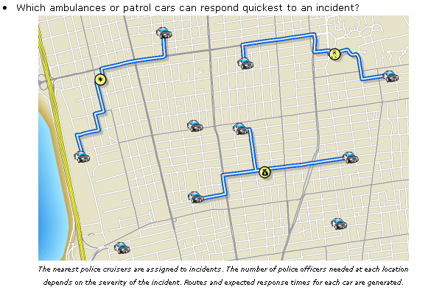
Closest Facilities

Slide 21
Proximity Analysis
GIS software can also support buffer generation that involves the creation of new polygons from points, lines, and polygon features stored in the database. For example, to know answer to questions like; How much area covered within 1 km of water canal? What is area covered under different crops? And, for watershed projects, where is the boundary or delineation of watershed, slope, water channels, different types water harvesting structures are required, etc.

Slide 22
Create a buffer: Raster

Slide 23
Create a Buffer: vector

Slide 24
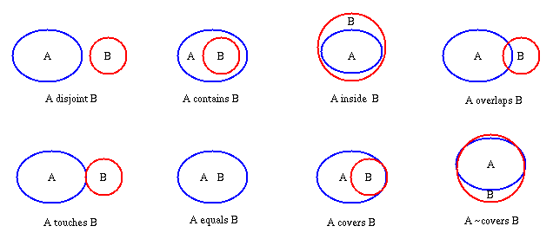
Topological Overlay Relations

Slide 25
Visualization
GIS can provide hardcopy maps, statistical summaries, modeling solutions and graphical display of maps for both spatial and tabular data. For many types of geographic operation the end result is best visualized as a map or graph. Maps are very efficient at storing and communicating geographic information. GIS provides new and exciting tools to extend the art of visualization of output information to the users.

